Slide 1
DevOps process Improve and visualize
Notes:
Author: Ahmed Hosni
1

Slide 2
Agenda
Part 1:
The problem (Why should i care?)
How does DevOps help?
What DevOps isn’t ...(DevOps Myths)
…and what it is
The journey
Part 2:
Workflow in the VSM
Limit Work in Progress (WIP).
Eliminate Hardships and Waste in the Value Stream.
Continually Identify and Evaluate Our Constraints.
Reduce the Number of Handoffs.
2
Notes:
https://fr.surveymonkey.com/r/RTRXGXG

Slide 3
The problem (Why should i care?)
Notes:
Author: Ahmed Hosni
3

Slide 4
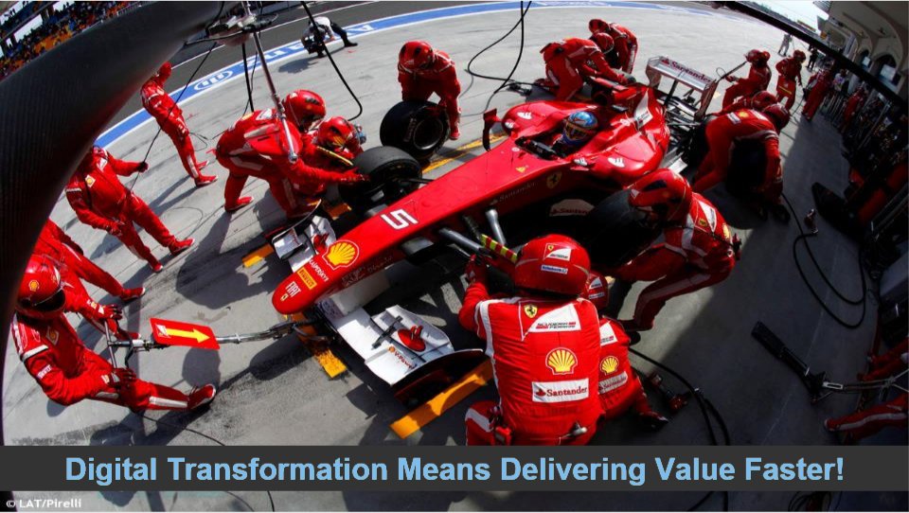
4

Slide 5
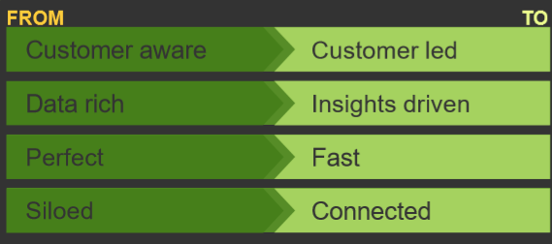
Digital Transformation requires Customer-obsessed DNA
5

Slide 6
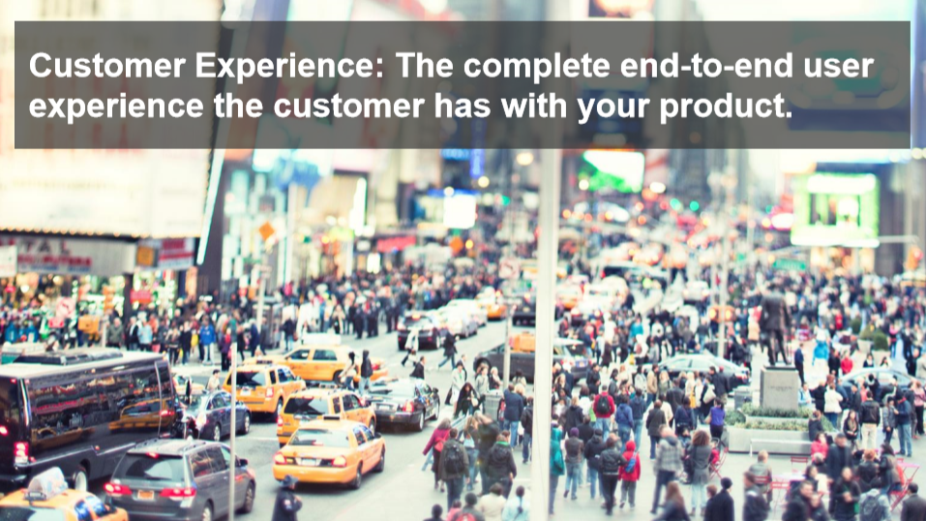

Slide 7
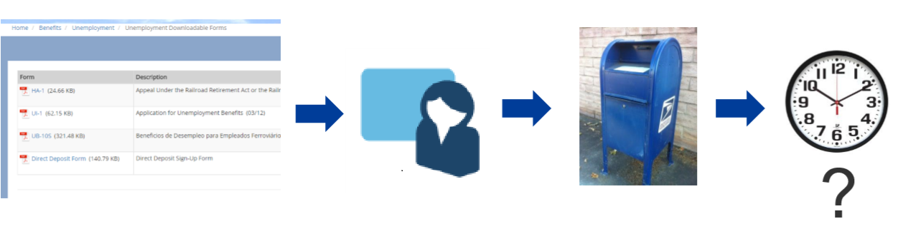
Before Digital Transformation
Processes Are Optimized for the Business…
…And the Customer Experience (CX) remains an afterthought
7

Slide 8
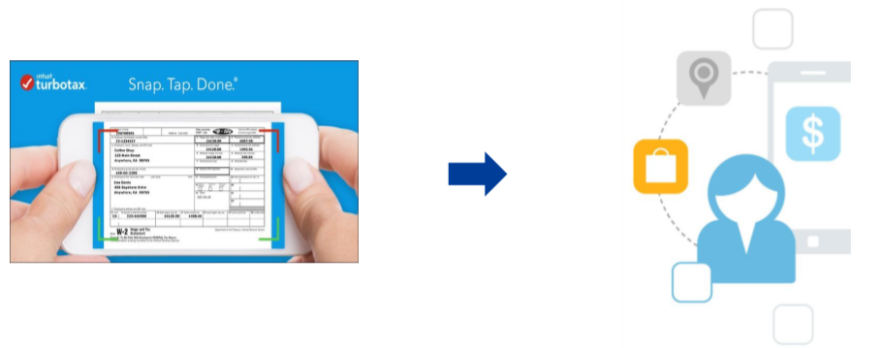
After Digital Transformation
Process Are Optimized for the Customer:
The user experience is optimized via direct connection to backend capability & processes.
8

Slide 9
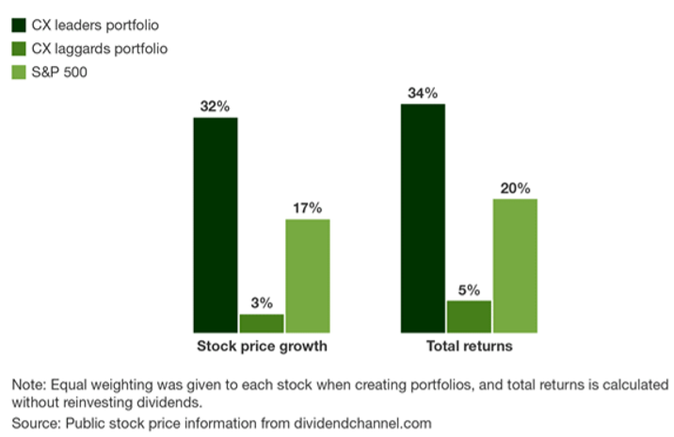
Customer Experience Matters!
CX leaders outperformed CX laggards on Stock Price growth and Total Returns.
9

Slide 10
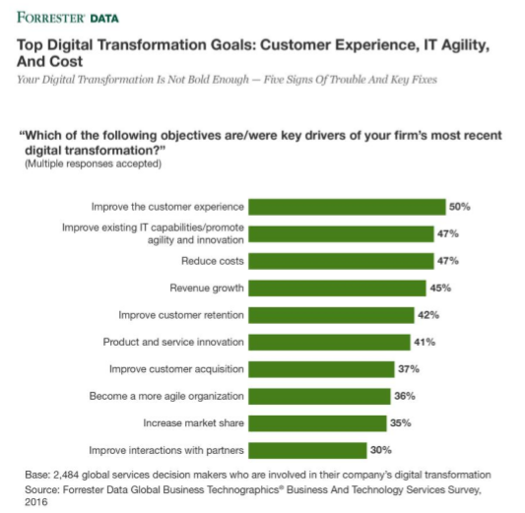
Leaders Recognize That IT Agility Is Core To Digital Business
10
Notes:
Forrester Report:
https://www.forrester.com/report/Your+Digital+Transformation+Is+Not+Bold+Enough+Five+Signs+Of+Trouble+And+Key+Fixes/-/E-RES137950

Slide 11
Each Industry Will Face Disruption
Ride Share & Self driving Cars.
Healthcare Admin being Disrupted by CVS and Amazon.
Amazon Enters the Grocery Business.
Airbnb and HomeAway are doing the same for the hotel and motel industry.
Traditional television distribution is being upended by digital distribution outlets such as NetFlix and Hulu.
Who’s Next?
The Common Thread is Placing The Customer 1st!
11

Slide 12
How does DevOps help?

Slide 13
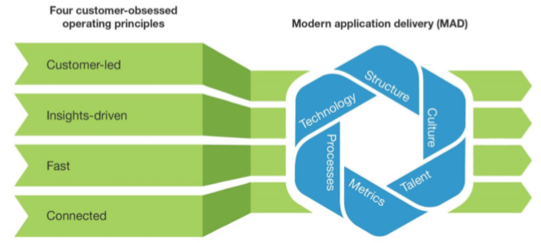
Embrace Modern Application Delivery To Accelerate Digital Transformation
13
Notes:
https://www.forrester.com/report/Faster+Software+Delivery+Will+Accelerate+Digital+Transformation/-/E-RES116443

Slide 14
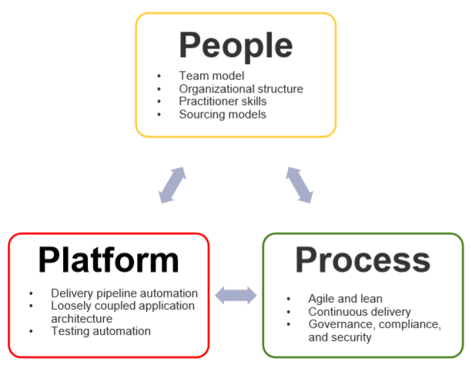
Agile + DevOps Requires: - People - Process - Platform
14

Slide 15
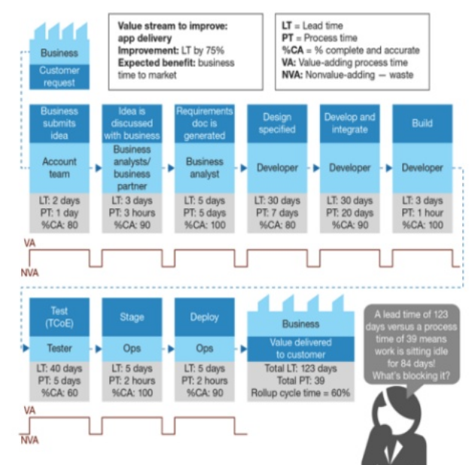
Use Value Stream Mapping To Guide Optimization of Your CI/CD Pipeline Transformation
15

Slide 16
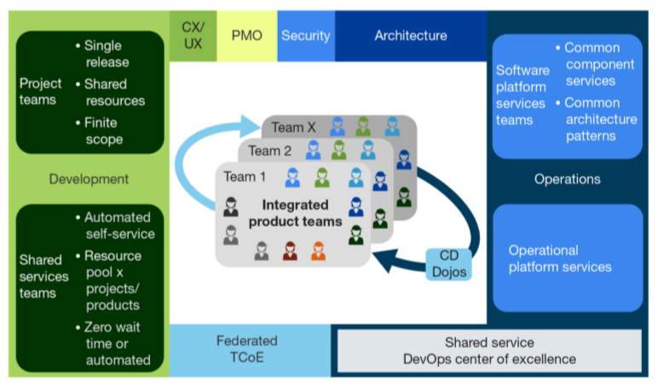
Create Integrated Product Teams
16

Slide 17
Create an integrated DevOps Pipeline Automate: - Verification - Testing - Configuration - Deployment - Metrics - KPIs
17

Slide 18
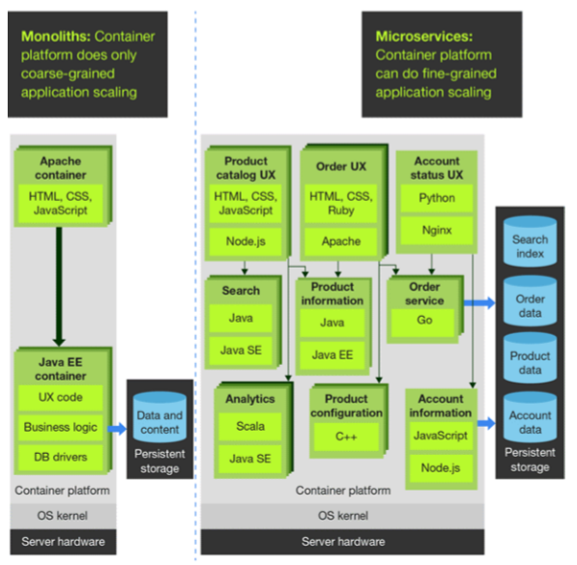
1- Modernize Application Architecture 2- Use Microservices to improve agility 3- Use Containers to simplify management
18

Slide 19
DevOps Trends
Having a complete, integrated tool chain is becoming a must have to accelerate software delivery.
AD&D Professionals are looking for integrated solutions or SaaS solutions to simplify tool chain management.
DevOps Vendors are consolidating to provide complete tool chains out of the Box.
The ability to model, integrate, manage, and monitor DevOps tool chains, end to end is a rapidly growing requirement.
19
Notes:
AD&D: Application Development & Delivery

Slide 20
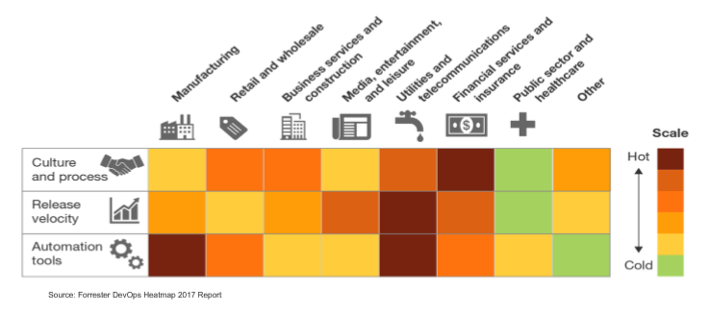
DevOps Heat Varies by Industry and Application Type
20

Slide 21
What DevOps isn’t ... (DevOps Myths)

Slide 22
Myth #1: DevOps is Only for Startups
Although DevOps practices were pioneered by web-scale,
Internet “unicorn” companies, each has risked going out of business because
of the problems associated with traditional “horse” companies.
However, these organizations were able to transform their architecture,
technical practices and culture to create the amazing outcomes
that are associated with DevOps.
22

Slide 23
Myth #2: DevOps Replaces Agile
DevOps does not bump heads with Agile, in fact the principles and practices are compatible.
Many have observed that DevOps is a logical continuation of the Agile journey.
Agile is an effective enabler of DevOps because it focuses on small teams delivering high quality code to customers.
23

Slide 24
Myth #3: DevOps is Incompatible with ITIL
To support the shorter lead times and higher deployment frequencies associated with DevOps, many areas of the ITIL processes become fully automated, solving many problems associated with configuration and release management processes.
Because DevOps requires fast detection and recovery when service incidents occur, the ITIL disciplines of service design, incident and problem management remain as relevant as ever.
24

Slide 25
Myth #4: DevOps is Incompatible with Information Security and Compliance
Instead of security and compliance activities only being performed at the end of the project,
controls are integrated into every stage of the daily work in the software development lifecycle,
which results in higher quality, security and compliance outcomes.
25
Notes:
The absence of traditional controls may dismay information security and compliance professionals.
However, that doesn’t mean that DevOps organizations don’t have effective controls.
Cryptojacking-tesla: https://redlock.io/blog/cryptojacking-tesla

Slide 26
Myth #5: DevOps Means Eliminating IT Operations, or “NoOps”
Many misinterpret DevOps as the complete elimination of the IT Operations function, but this is rarely the case.
While the nature of IT Operations work may change, it remains as important as ever.
26

Slide 27
Myth #6: DevOps is Just “Infrastructure as Code” or Automation
While automation is a requirement for many DevOps patterns, DevOps also requires cultural norms and an architecture that allows for the shared goals to be achieved throughout the IT value stream.
27

Slide 28
Myth #7: DevOps is Only for Open Source Software
Although many DevOps success stories take place in organizations using software, such as the LAMP stack (Linux, Apache, MySQL, PHP), achieving DevOps outcomes is independent of the technology being used.
Successes have been achieved with applications written in Microsoft .NET, COBOL and mainframe assembly code, as well as with SAP and even embedded systems.
28

Slide 29
DevOps Model Defined

Slide 30
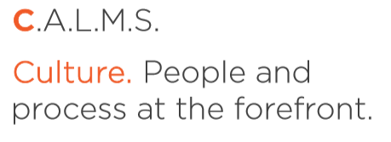
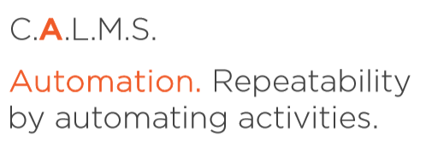
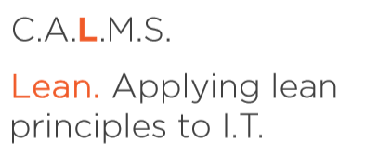
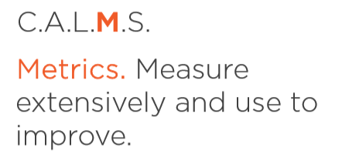
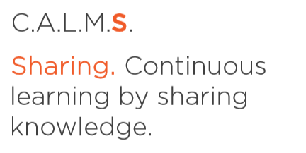
Defining DevOps
30
Notes:
DevOps is the combination of cultural philosophies, practices, and tools that increases an organization’s ability to deliver applications and services at high velocity:
Evolving and improving products at a faster pace than organizations using traditional software development and infrastructure management processes.
This speed enables organizations to better serve their customers and compete more effectively in the market.

Slide 31
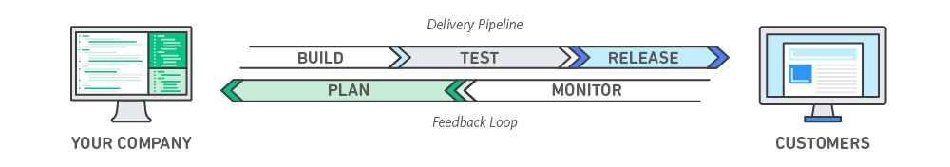
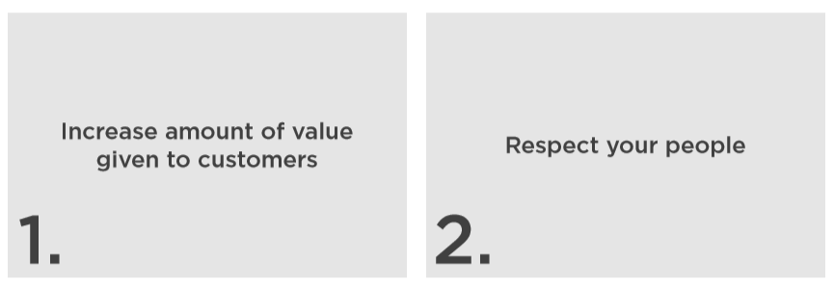
What Do You Want to Accomplish?
31

Slide 32
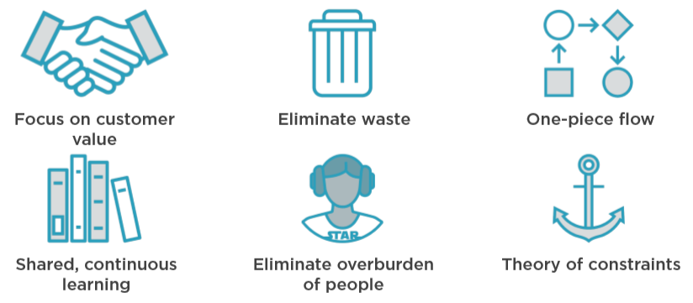
What’s Lean All About?
32

Slide 33
The journey
Notes:
Agree and communicate measurable business goals
Give teams support and resources to experiment
Talk to other teams
Achieve quick wins and share learnings
Keep going

Slide 34
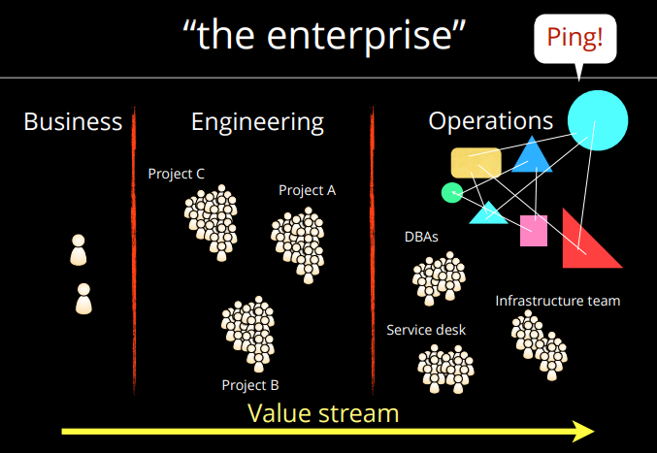
34

Slide 35
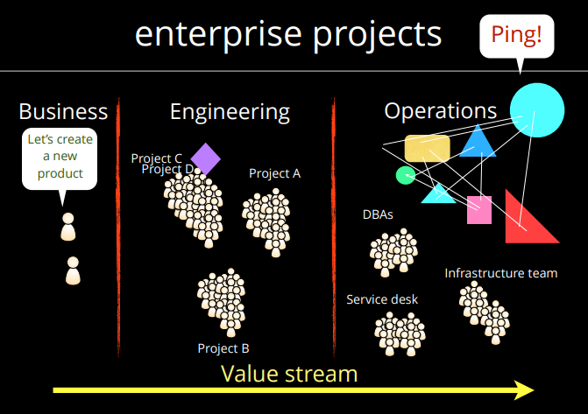
35

Slide 36
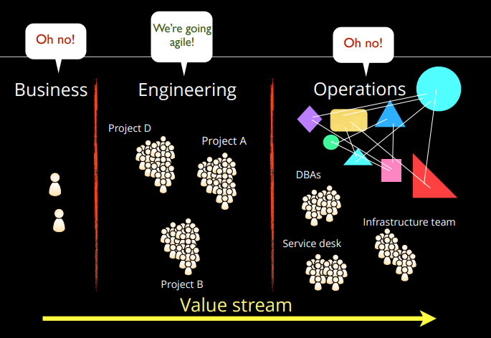
36

Slide 37
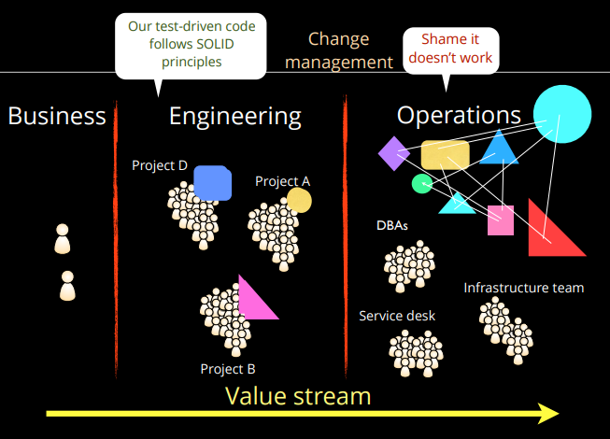
37

Slide 38
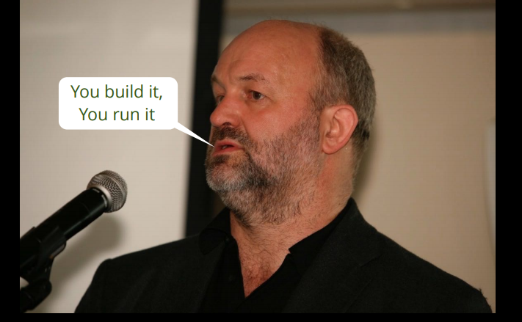
38
Notes:
The ”You Build it, you run it” quote from the CTO of Amazon, Werner Vogels

Slide 39
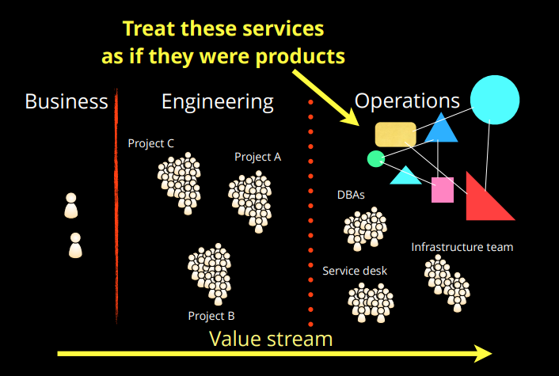
39

Slide 40
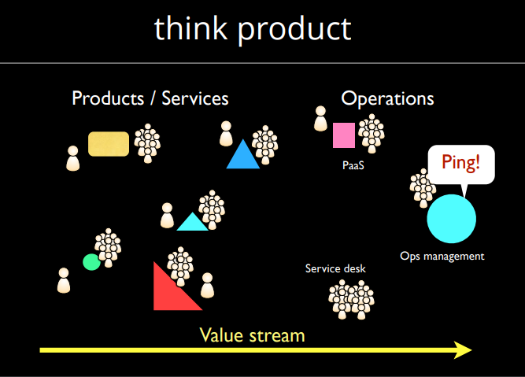
40

Slide 41
Case Study: The HP laserjet firmware

Slide 42
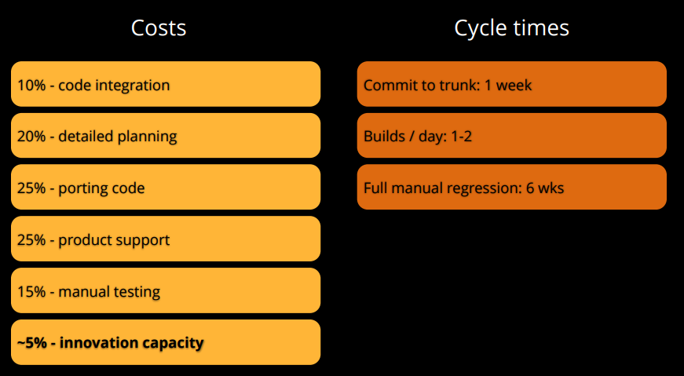
HP laserjet firmware in 2008
42

Slide 43
Future Smart re-architecture
Reduce hardware variation
Create a single package
Implement continuous integration
Implement comprehensive test automation
Create a simulator
43

Slide 44
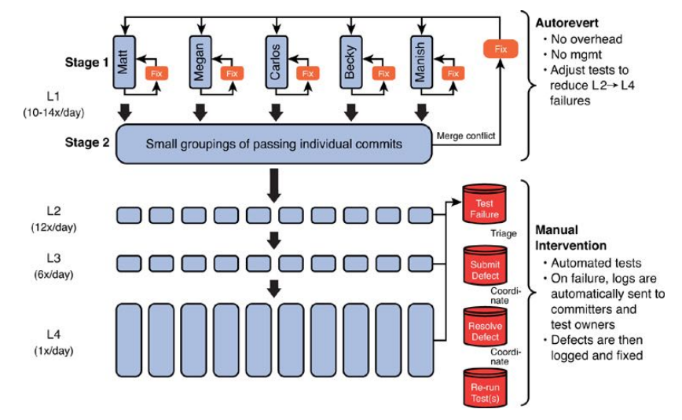
Deployment pipeline
44

Slide 45
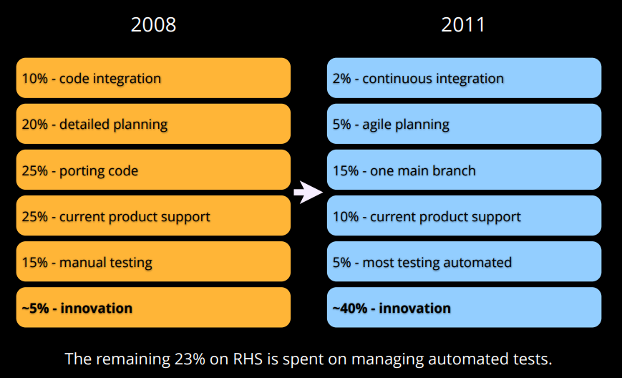
HP laserjet firmware in 2011
45

Slide 46
The economics
2008 to 2011
• Overall development costs reduced by ~40%
• Programs under development increased by ~140%
• Development costs per program down 78%
• Resources now driving innovation increased by 8X
46

Slide 47
Workflow in the VSM

Slide 48
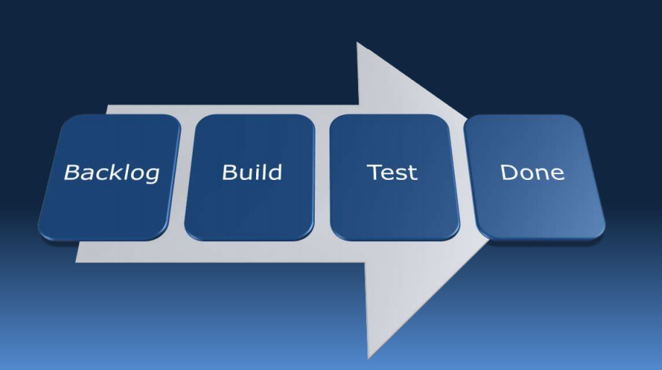
Agile business intelligence
The flow
48

Slide 49
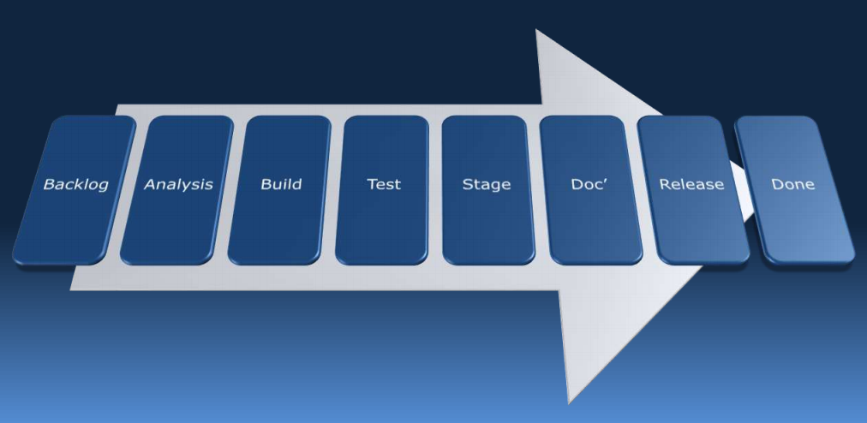
Agile business intelligence
The flow
49

Slide 50
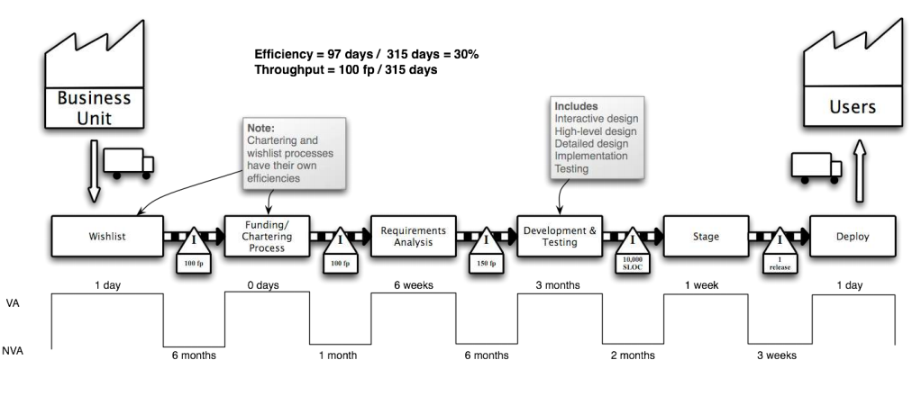
Agile business intelligence: The flow
50

Slide 51


Value stream mapping?
Defines the ‘as-is’ steps & roles for each task
51

Slide 52
Value add (VA)?
Time spent on outcomes for the customer
52

Slide 53
Non-value add (NVA)?
Time spent between steps
53

Slide 54
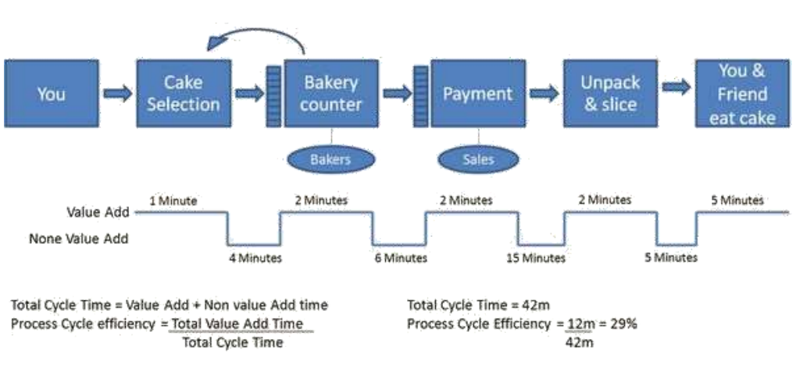
Example
54

Slide 55
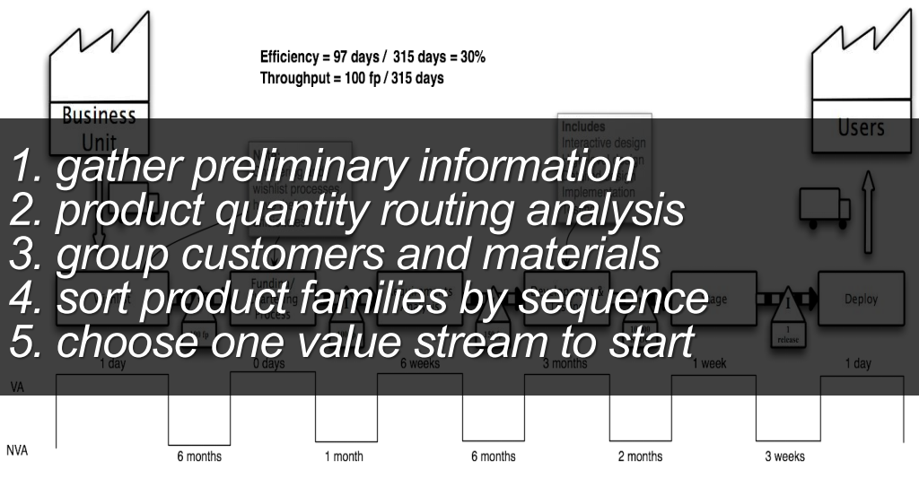
Steps
55

Slide 56
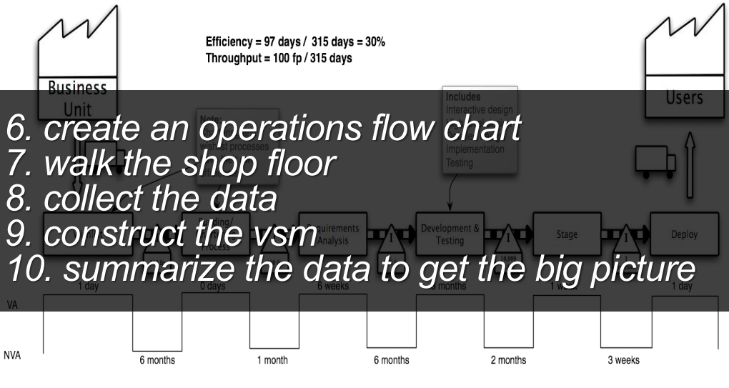
Steps
56

Slide 57
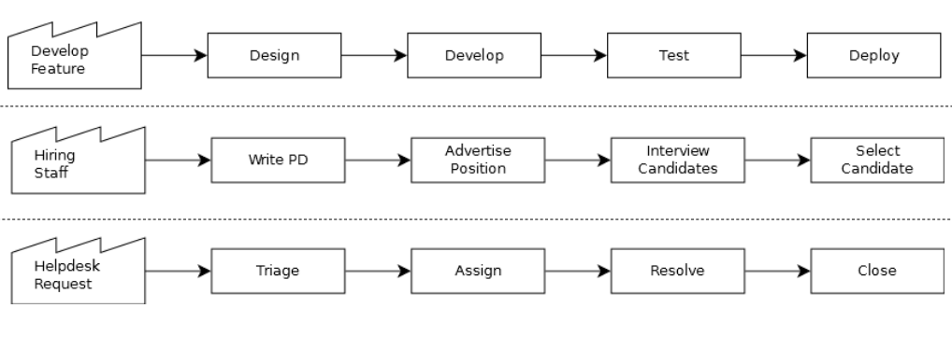
Identify, isolate and define the process
57

Slide 58
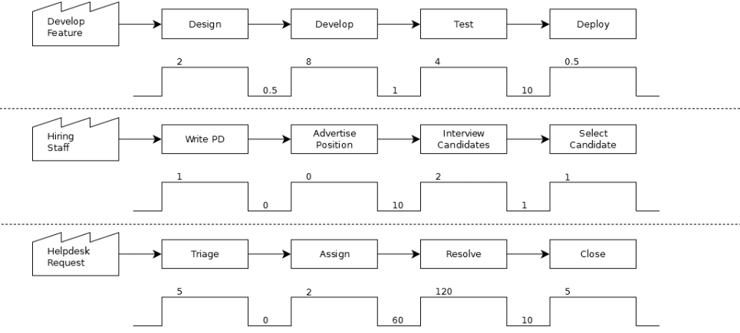
Measure the average VA and NVA
58

Slide 59
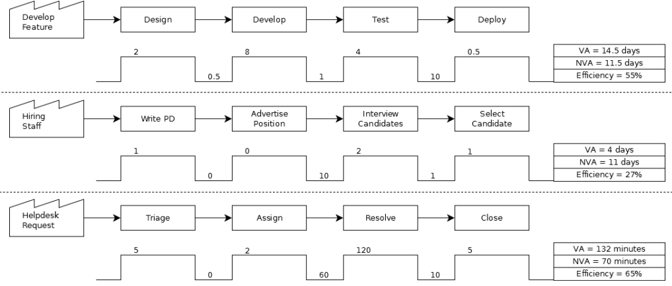
Calculate process efficiency = (VA / VA + NVA)
59

Slide 60
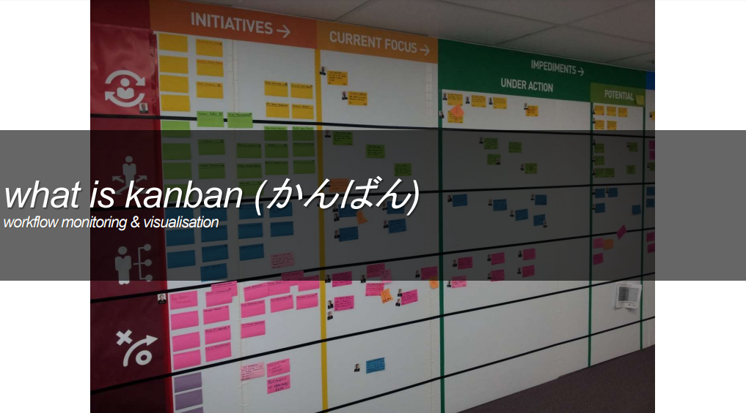
60

Slide 61
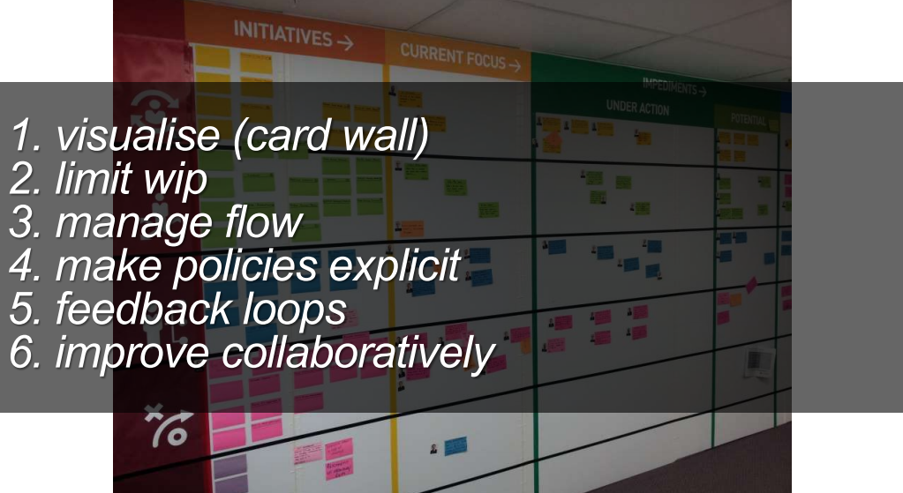
61

Slide 62
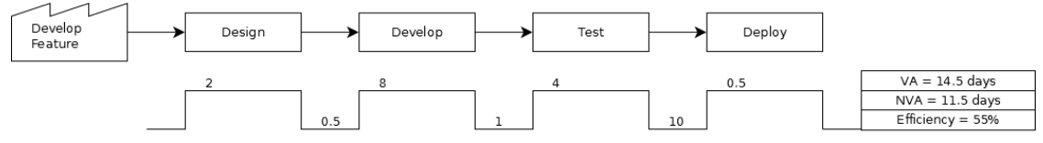

Min throughput is usually = team size
If your efficiency was 100%, how many “x” could you do simultaneously?
62

Slide 63
Total WIP = min throughput / efficiency
e.g. 7/55% ~= 13
Assuming a software team of 7 (not pairing)
What is your total WIP?
63

Slide 64
% Effort = state VA / total VA
e.g. 4 / 14.5 ~= 28%
Calculate % effort per state
64

Slide 65
WIP = total WIP * % effort
e.g. 13 * 28% ~= 4
Proportion WIP by state
65

Slide 66
Design WIP = 2
Develop WIP = 7
Test WIP = 4
Deploy WIP = 1
Proportion WIP by state
66

Slide 67
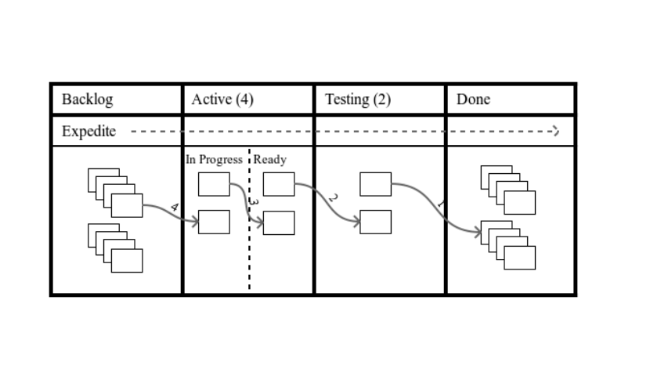
“pull” all ready tasks to WIP limit
67

Slide 68
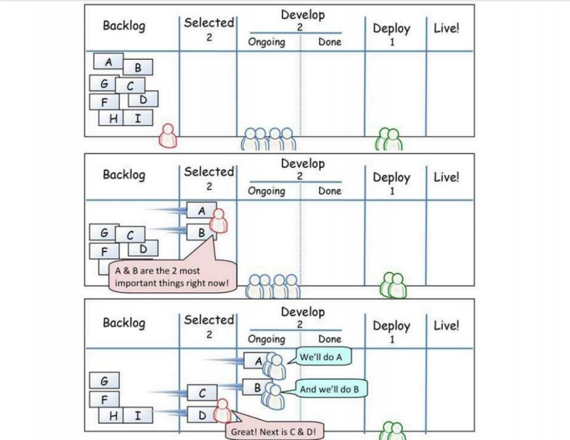
68

Slide 69
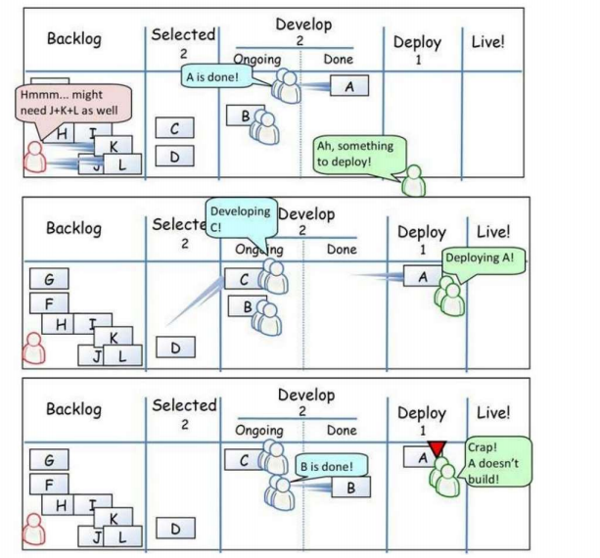
69

Slide 70
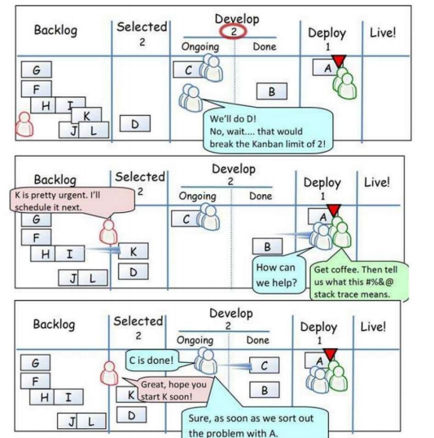
70

Slide 71
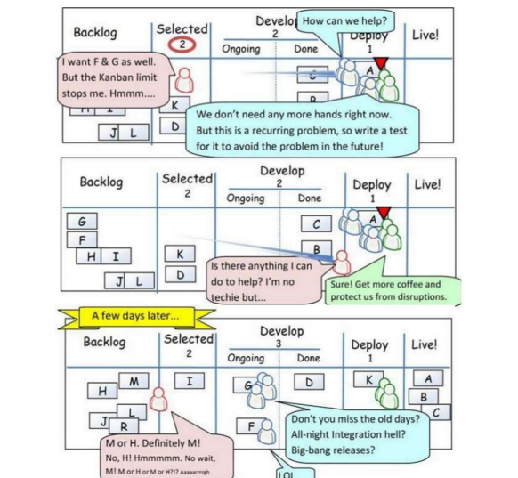
71

Slide 72
Identify & resolve bottlenecks?
Through low WIP limits and strict process flow
72

Slide 73
Production levelling?
Constant rate of flow through all states
73

Slide 74
Cycle time?
Average time to complete a task from start
74

Slide 75
Lead time?
Average time to complete a task from request.
75

Slide 76
Progress monitoring?
Cumulative flow diagram
Statistical run chart
Burndown/up chart
76

Slide 77
Effort visualization?
Plot delivered functionality against duration
77

Slide 78
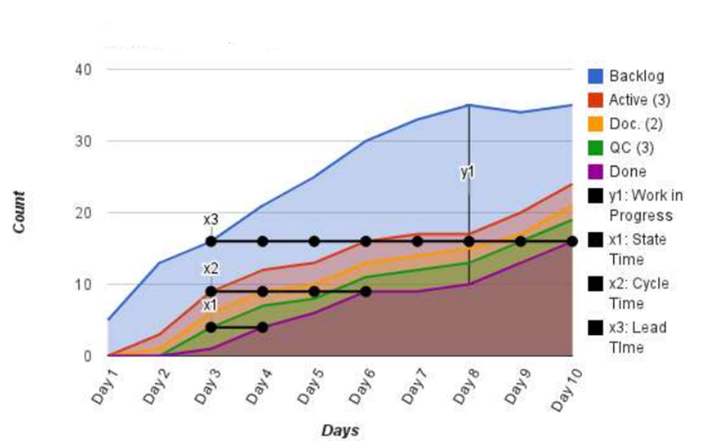
Cumulative flow diagram
78

Slide 79
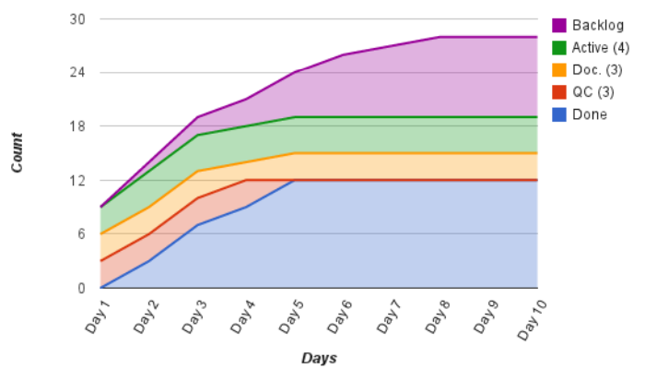
Bottleneck
79

Slide 80

Poor flow
80

Slide 81

Large WIP
81

Slide 82

Long lead time
82

Slide 83

Plateau
83

Slide 84
Duration visualization?
Plot cycle time against average!
84

Slide 85

Cycle time run charts
85

Slide 86

Process trend
86

Slide 87

Process shift
87

Slide 88

Extreme process variation
88

Slide 89
Effort visualization?
Plot delivered functionality against
velocity!
89

Slide 90
Velocity?
How much work can be delivered per iteration!
90

Slide 91

Burnup chart
91

Slide 92

Burndown chart
92

Slide 93

Discovery
93

Slide 94

Scope creep
94
Notes:
When a project stretches far beyond its original vision, it is called “scope creep”.
This often refers to changes, continuous or uncontrolled growth in a project’s scope, at any point after the project begin

Slide 95

Plateau

Slide 96

Too many features

Slide 97

Tracking epics

Slide 98
Planning Tools Issue Tracking Tools

Slide 99

Examples of Planning Tools

Slide 100

Examples of Issue Tracking Tools

Slide 101


Atlassian Jira Control Chart
Notes:
https://confluence.atlassian.com/jirasoftwareserver070/control-chart-777002852.html

Slide 102


What did we learn?
USING THE VALUE STREAM MAPPING:
Improve Alignment Between Operations (Bus) & Development (IT).
Provides Transparency and Visualizes Product Enhancements.
Helps Improve your organization of “Teams of Agile Teams”.
Improves Flow of Value.

Slide 103





Some recommended readings
103

Slide 104
Questions?

